Slide 1
Title I
Committed to High Performance
Academic Achievement
Evidence-Based Practices
Comprehensive and Targeted Support
Accountability
Parent and Family Engagement
Direct
Student Services
College and Career Readiness

Slide 2
Annual Title I Meeting
Presented by
Mrs. Kelley Starks, Principal

Slide 3
Vision
The vision of Clayton County Public Schools is to be a district of high performance preparing ALL students to live and compete successfully in a global society.

Slide 4
Mission
The mission of Clayton County Public Schools is to empower students to achieve academic and personal goals.

Slide 5
What Is A Title I School?
Title I of the Elementary and Secondary Education Act of 1965 (20 U.S.C. 6301 et seq.) is amended to read as follows:
• Title I funds aim to bridge the gap between low-income students and other students. The U.S. Department of Education provides supplemental funding to local school district to meet the needs of at-risk and low-income students.
• Title I is the nation’s oldest and largest federally funded program, according to the U.S. Department of Education.

Slide 6
Purpose of Title I
Title I serves to ensure that
all children have a fair, equal,
and significant opportunity to obtain a
high-quality education and reach, at
a minimum, proficiency on challenging
state academic achievement standards
and state academic assessments.

Slide 7
School-wide vs. Targeted Assistance
School-wide Assistance
Targeted Assistance
* Comprehensive site plan in which parents are invited to give input
* The entire school benefits from Title I
* Students are identified
* Targets on students who are academically at risk of failing
* Ranking system is utilized to see who will be served
* Campuses with a low-income percentage of 35-40% are considered a “targeted assistance” campus.
Notes:
Is your school a school wide Title school or targeted assistant?
School wide –
Targeted Assistant-
All students in CCPS receive free breakfast and lunch based on the Community Eligibility Provision (CEP) previously known as the CEP Community Eligibility Option (CEO)
It was Designed as an alternative to household applications for students/families already “qualified” by alternative means. SNAP, TANF, HOMELESS etc.
The SNAP, TANF and Homeless information
Identified students/number of enrolled students should be greater than or equal to 40%
At least 40% per school
Any building with less than 40% low income.
Eligible children:
Children not older than 21.
Children identified as “failing , or most at risk of failing
Students served in the previous two years under the Migrant Program
Any child who participated in Head Start, Even Start, The Early Reading First, within the previous two years.
Any child a community day program or living in a a neglected or delinquent institution.
Any child who is homeless
Selection for services is based entirely in low achieving, not low income.

Slide 8
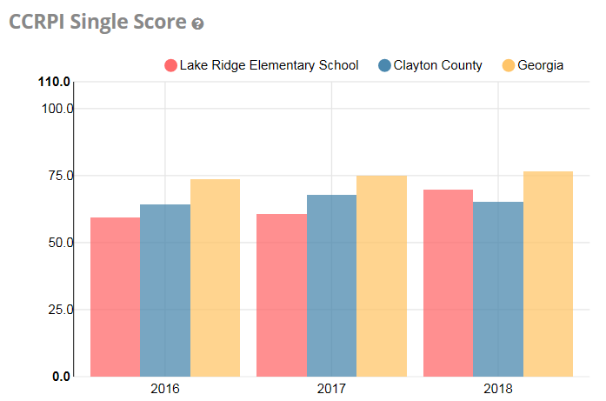
Georgia Schools Report

Slide 9
Uses of Title I Funds
Additional Personnel
Computers/Laptops
Take Home Resources
Remediation
Supplemental Educational Services
Supplementary materials to address student needs
Parental Involvement
Professional Development
Online Learning
~ Supplementary ~
a : something that completes or makes an addition. b : a part added to or issued as a continuation of.
http://www.merriam-webster.com/
Notes:
Note: Remember to add, “There is a perfect analogy that my supervisor, Ms. Katrina Thompson, the Director of Federal Programs uses as to illustrate the role of Title I. Proceed to tell the basement analogy.

Slide 10
Supplemental Materials
Technology Labs
Wireless Laptop Carts
iPod Carts
Smart Tables
Student Response Systems
Class Libraries
Parental Resources
Instructional Supplies for students and teachers

Slide 11
Instructional Support
Schools can use their Title I funds to reduce class size by hiring additional teachers and/or paraprofessionals.
Title I funded staff work directly with the classroom teacher to support at-risk students.
The Office of Federal Programs coordinates Tutorial Services for students who need additional support beyond the school setting.
Additional monitoring of these staff members will come from the Office of Federal Programs to ensure compliance.

Slide 12
Parent and Family Engagement Policy
Federal
Each local educational agency (LEA) that receives Title I, Part A funds must develop jointly with, agree on with, and distribute to , parents of participating children a written parental involvement policy that contains information required by Section 1118(a)(2) of the Elementary and Secondary Education Act (ESEA).
Local
The school level parent involvement policy establishes the backbone to support the required steps necessary to build capacity for parent involvements as described by Section 1118(b) of the Elementary and Secondary Education Act (ESEA).

Slide 13
What is Required by Law for Parent Engagement?
Notification of Highly Qualified Teacher Status (Parent’s Right to Know)
Notification of School Status
1% of System Allocation must be reserved for Parent Involvement

Slide 14
Professionally Qualified Teacher
What is a parent’s right to know?
As a Title I school, we must meet federal regulations related to teacher qualifications as defined in ESEA. These regulations allow you to learn more about your child’s teachers’ training and credentials. We are happy to provide this information to you. At any time, you may ask:
Whether the teacher met state qualifications and certification requirements for the grade level and subject he/she is teaching,
Whether the teacher received an emergency or conditional certificate through which state qualifications were waived, and
What undergraduate or graduate degrees the teacher holds, including graduate certificates and additional degrees, and major(s) or area(s) of concentration.

Slide 15
Use of Funds for Title I Parent Engagement Sample 1% Budget Here is what it looks like…
Lake Ridge Elementary
Title I Parental Involvement Budget Survey
Title I-A requires the utilization of 1% of the funds to support and promote parental and family engagement in schools.
The district is required to use 1% of those funds for parental involvement as well. Lake Ridge Elementary uses Title I funds to purchase materials for our classrooms to ensure that all students have materials to enhance as well as to close achievement gaps.
Title I funds afford our students to participate in various educational activities. Through Title I we are able to have activities to engage our parents and community in joining our school’s various programs and activities.
We are able to purchase materials for our parents to use with their student at home and at school.
We are also able to have an “Afterschool Remediation” program for our students to bridge weaknesses in academics.

Slide 16
How is Title I Parent and Family Engagement Money Spent?
Title I Budget Allocation:
Last school year (2018-2019), we had $2,604.00 in the Title I Parental Engagement budget. The survey feedback we received from parents last school year, requested we spend the money as follows:
Materials to support instruction and curriculum
Supplemental materials to support instruction at home
Translations for Title I Parent Notices
Building Capacity Workshops for Parents
Note: Our 2019-2020 budget is $2,508. Parents were invited to meetings last week to give input about how that should be spent.

Slide 17
Overview of Parent and Family Engagement
Parent and family engagement is the participation in meaningful, two-way communication involving student academic learning and other school activities; to ensure that:
Parents play in integral role in assisting in their student’s learning.
2. Parents are encouraged to be actively involved in their child's education at school.
3. Parents are full partners in their student’s education and are included in decision making as well as being a part of the advisory committees to assist in the education of their child.
4. Other activities are carried out, such as those described in section 1118.

Slide 18
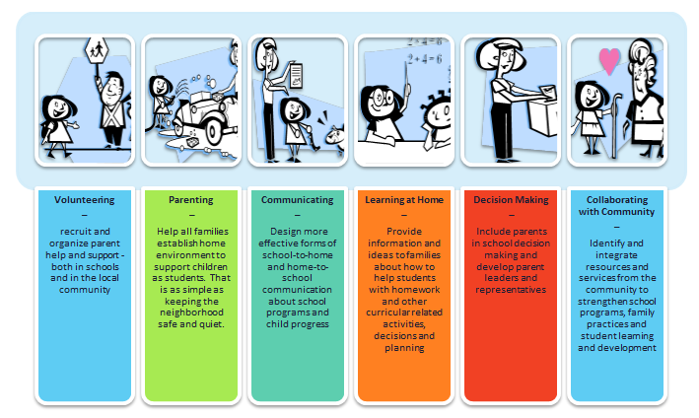
Six Types of Family Engagement
Notes:
Explain how Title I supports the Parent Academy, Parent Resource Rooms, etc.

Slide 19
Parents and Family Decision-Making Opportunities
Teacher-Parent Conferences
School Council
Title I Survey (Fall and Spring)
School-Parent Compact Revisions

Slide 20
What Opportunities Are There for Parents and Families To Be Involved at ….?
Participating on school committees to support student success
Sharing your skills/ Planning school events
Volunteering
Attending Workshops
Serving as workshop instructors/ facilitators
Completing Surveys (your input is important to us)
Other school events and activities: Grits for Grandparents, Donuts for Dads, Muffins for Moms and Bring Your Parents To School Day and more!

Slide 21
How to Contact Our Staff?
Call the school
Email your child’s teacher or other staff members
Call or email the parent liaison
View the School’s Website
Infinite Campus is available to all parents and families

Slide 22
Quote of the Day
Notes:
Discuss the role of the paraprofessional in the classroom

